Slide 1

Practical 4
Hacking WPA2-PSK Encryption Key using Airgeddon
Ethnical Hacking
Diploma in ISF Year 3 (2020/21), Semester 5
Notes:
Left-hand Bar – Replace FSP by your module code and X by the lecture number.
Replace Lecture Title
Replace < Module Name >
Replace Year and Semester if necessary

Slide 2
Introduction
Airgeddon is an easy to use bach script written for assessing the security of wireless networks. It is developed and maintained by v1s1t0r1.
Do Son shares the various features of the software in his article called "airgeddon v10.20 realeases: All-in-one Wireless Toolkit ".

Slide 3
Learning Objectives
At the end of this practical, the students would be able to
crack the WPA2-PSK key in any WiFi network that make use of such authentication scheme and use it to connect to the wireless network.
The students would also be able to explore and carry out attacks on other form authentication scheme using the same tool.

Slide 4
Contents
Tasks
Task 1 - Setup and Start Airgeddon in Kali Linux 2021.1
Task 2 - Start Airgeddon and Scan for APs
Task 3 - Select Target AP to obtain Hand-Shake
Take 4 - Crack WPA2-PSK Encryption Key
Challenge
Note: You need to go through the Tasks sequentially for the 1st practice. And subsequently, you may choose Task 4 for just performing the cracking of key or Task 1-3 to obtain the hand-shake.

Slide 5
Important Instructions
Do this exercise on your own notebook IN THE LAB.
Open Kali Linux in a VM player.
The network setting set to NAT.
Loan a USB Wireless adapter from level 8 Admin office and connect it to your Kali Linux VM as an External Device.
Connect to NPWiress to check the functioning of the device.
If the VMs appeared to be slow, you need to increase the memory and number of processor of the respective VM.

Slide 6
You can also do this lab practical using the desktop PC in the lab but you need to boot up Kali Linux from the hard-disk partition.
The Desktop PC has Wireless Network Device and Kali Linux boot up from the partition will connect directly to the wireless network device and you do not need a external USB Wireless Adaptor.
The userid and password is “ict:toor”

Slide 7
Task 1 - Setup and Start Airgeddon in Kali Linux 2021.1

Slide 8
You can also do this lab practical using the desktop PC in the lab but you need to boot up Kali Linux from the hard-disk partition.
The Desktop PC has Wireless Network Device and Kali Linux boot up from the partition will connect directly to the wireless network device and you do not need a external USB Wireless Adaptor.
The userid and password is “ict:toor”

Slide 9

Airgeddon source code is located at Git Repository - https://github.com/v1s1t0r1sh3r3/airgeddon.
Login into your Kali Linux OS, start a terminal and change the user to root.

Slide 10
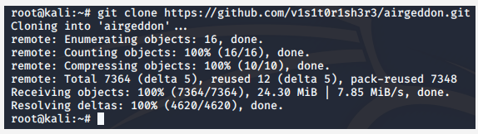
Clone the code into your computer by issuing the following command line:
#git clone https://github.com/v1s1t0r1sh3r3/airgeddon.git
Let the cloning process finish on its own.

Slide 11
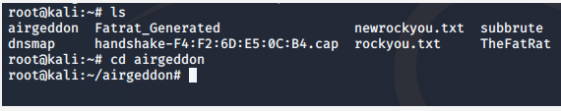
Get into the directory where Airgeddon has been cloned.

Slide 12
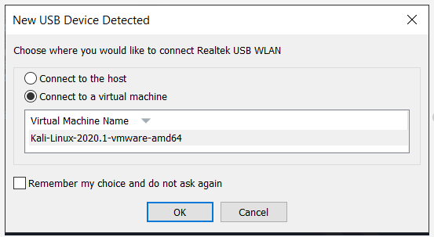
Before you launch Airgeddon, plug in your USB Wireless Adapter and make sure it is connected to your Kali VM.

Slide 13
Disable the NetworkManger and disable all processes that might interfear the experiment by issuing the following two commands
#service NetworkManager stop
#airmon-ng check kill

Slide 14
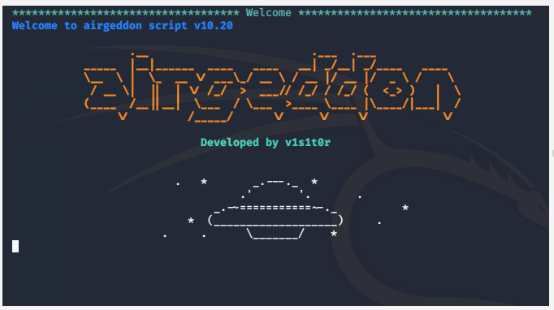
Start Airgeddon by issuing the command:
#bash airgeddon.sh

Slide 15
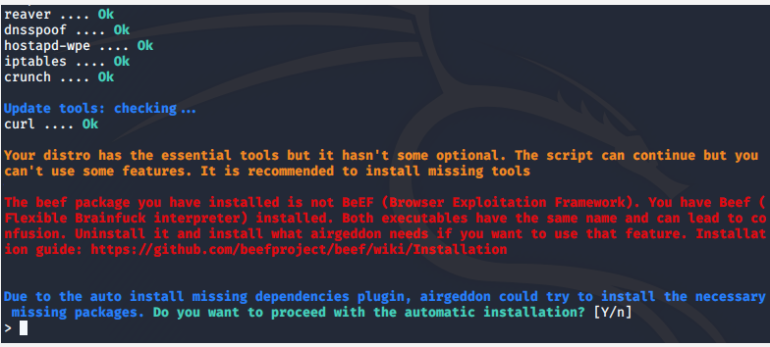
The script may detect conflict in our Linux distribution and ask you for action as follows, enter “y” to continue.

Slide 16
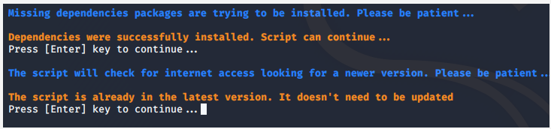
The script will continue to check for dependencies and version, enter to continue...

Slide 17
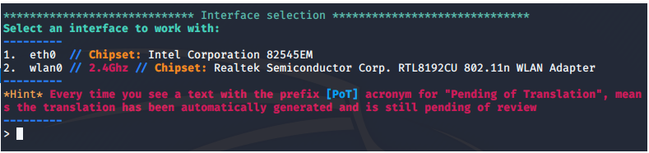
Your will then be asked to choose the network adapter to be used, select the wireless LAN adapter.

Slide 18
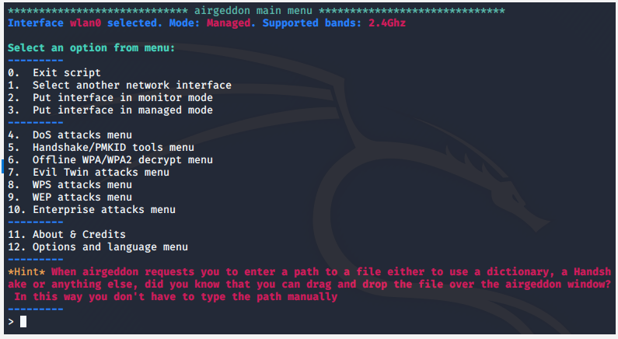
Next, you will see the following screen appeared. You are now armed to carry out attacks !
-- End of Task 1 --

Slide 19
Task 2 - Start Airgeddon and Scan for APs

Slide 20
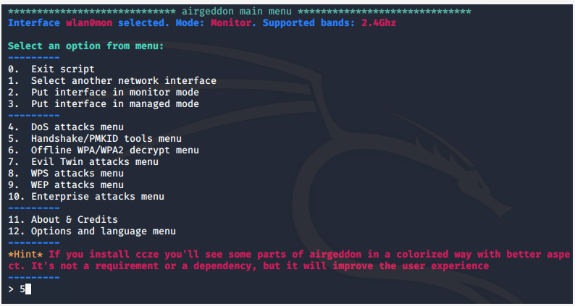
Select 5 to for Handshake Tools menu...

Slide 21
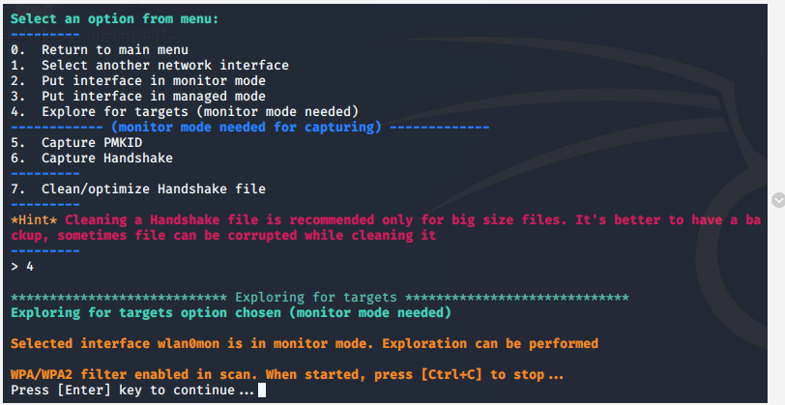
Select 6 to capture handshake. Refer to the extra to learn about TCP handshake...

Slide 22
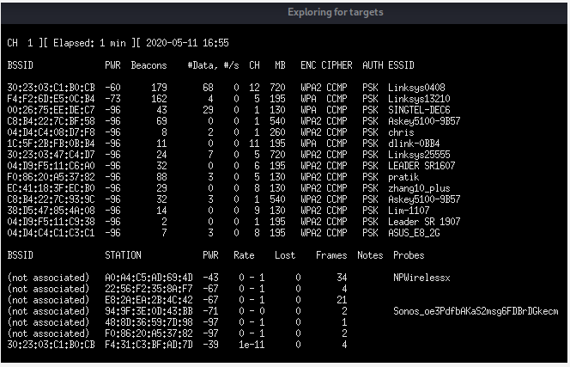
First we need to look for target wireless router, or BSSID. Refer to extra for TERMS used in wireless technology posted in MeL. Press <Ctrl> <c> keys together once you see the SSID of your router in the ESSID column...

Slide 23
SSID to be used for this Practical…
ICT-ISFGLOBAL-HQA
ICT-ISFGLOBAL-HQB
ICT-ISFGLOBAL-B1A
ICT-ISFGLOBAL-B1B

Slide 24
You need to make sure your tutor has set traffic to make use of these wireless AP.
Please remind him to connect to these routers and generate some traffics.

Slide 25
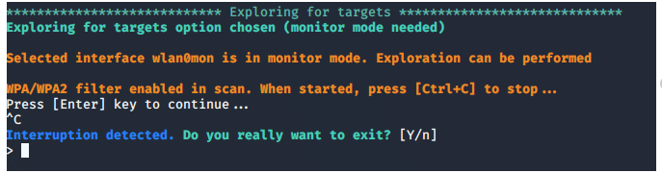
Press enter to continue ...

Slide 26
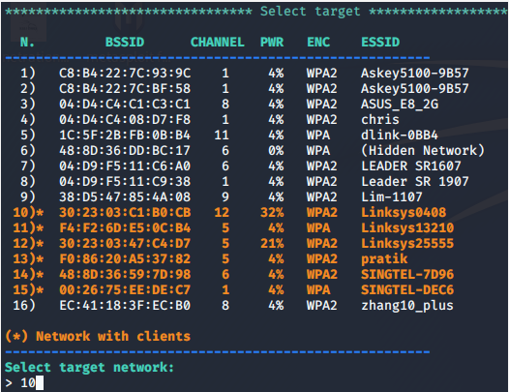
A list of available AP will be listed for your selection. Select only the AP belong to the lab ...
-- End of Task 2 -

Slide 27
Task 3 - Select Target AP to obtain Hand-Shake

Slide 28
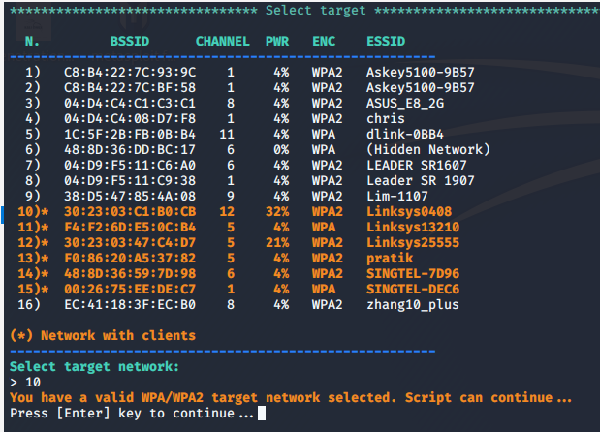
After you have selected your AP, press [enter] to continue...

Slide 29
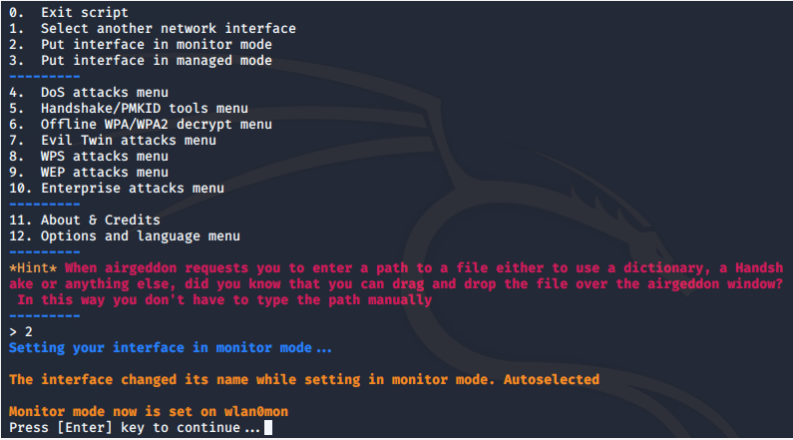
Choose 2 to make sure the previously selected interface card is in monitor mode (if you need to)

Slide 30
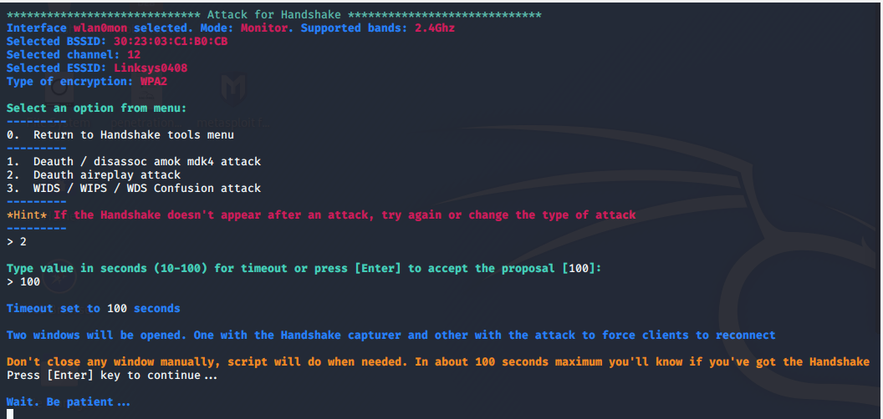
Select the time to listen for a handshake...

Slide 31
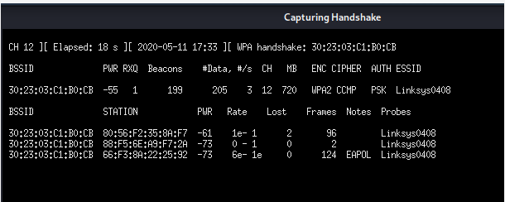
The capturing process started and there is nothing for you to do but just wait...

Slide 32
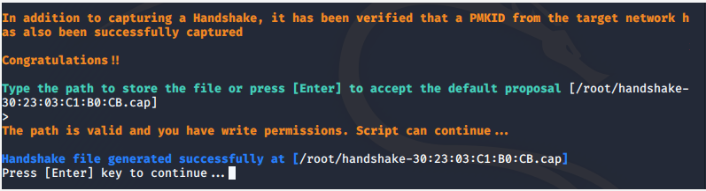
Once a hand-shake is detected, the program will stop and ask you to save the data into a file. Just press [enter] to accept to continue...
-- End of Task 3 --

Slide 33
Take 4 - Crack WPA2-PSK Encryption Key

Slide 34
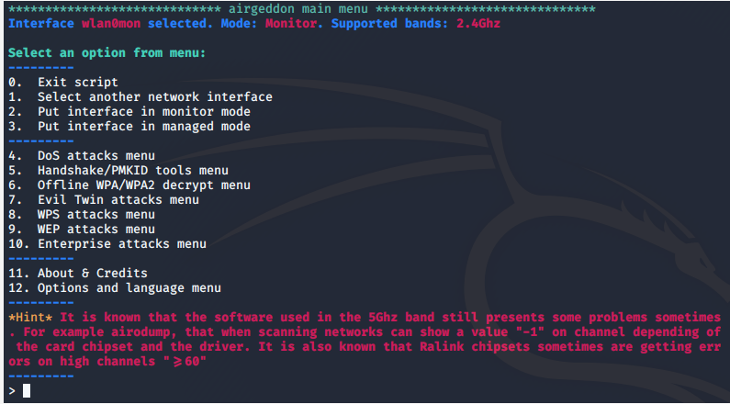
We will now start the key cracking process. Select 6 for Offline WPA/WPA2 decryption menu...

Slide 35
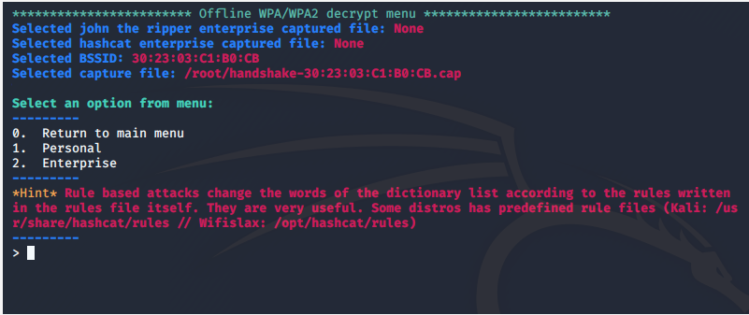
Select Personal ...

Slide 36
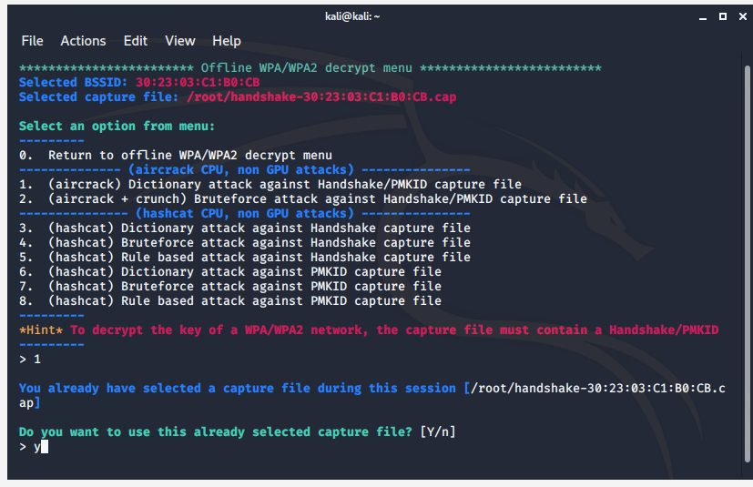
Select 1 for Dictionary attack against Handshake capture file.

Slide 37
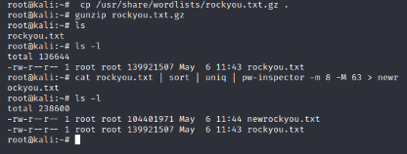
Before you move on. Start a new terminal and following the following steps to obtain a newrockyou.txt password file and use it in the attack:
The link below explains the difference between the two files.
Source: http://cybertheta.blogspot.com/2017/08/password-dictionary.html

Slide 38
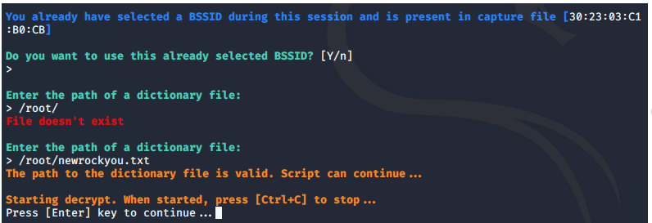
Go back to the first terminal and press “y” to continue. You will be prompted for the DSSID and file dictionary to be used for the attack, press enter and enter /root/newrockyou.txt when asked. Notice is not the path.

Slide 39
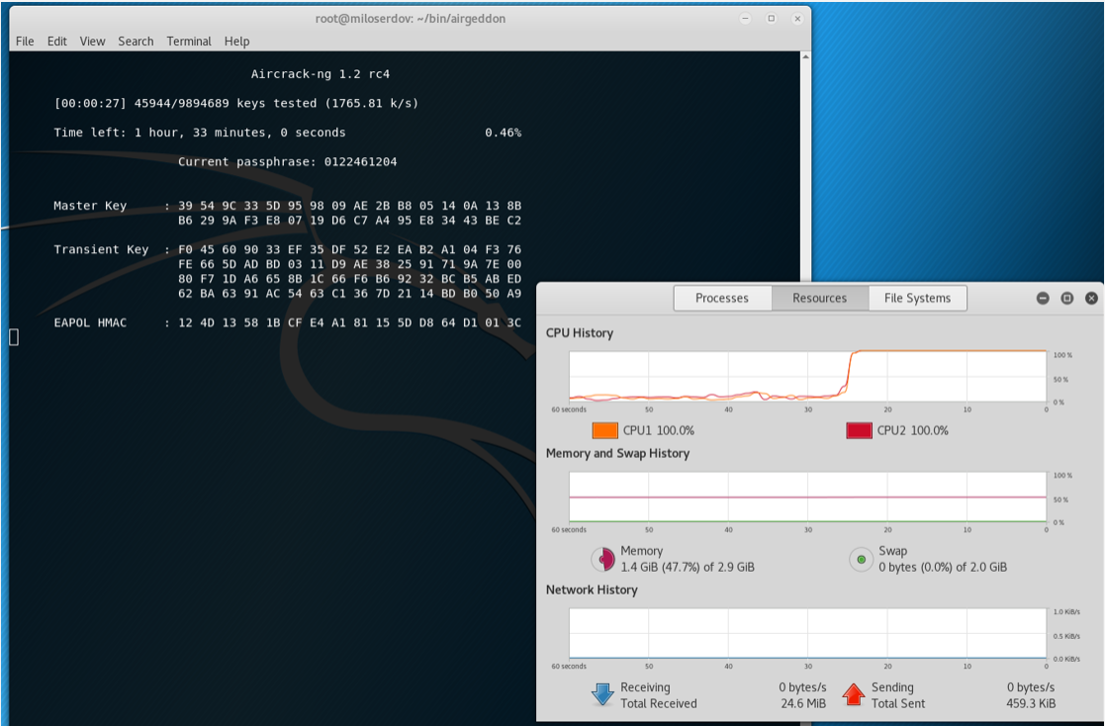
Cracking process starts, notice the jump in CPU utilization.

Slide 40
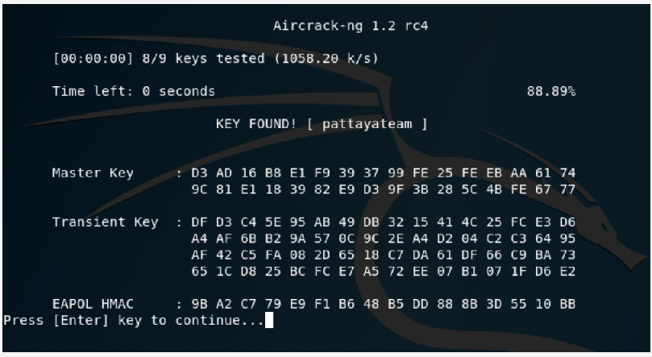
Key found.

Slide 41
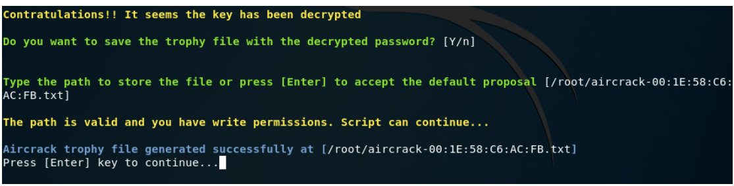
Well done !

Slide 42
Challenge 4.1

Slide 43
Challenge 4.1
Work in team of 2 and research on the Internet to find ONE other method to crack PSK-WPA2 wireless encryption key.
Test it with your home network AP and record the steps in a PowerPoint file and submit it to your class's team week 3 channel.
Name your file as Cha4.1- members' full name
Complete this exercise before week 7.

Slide 44
End

